Slide 1
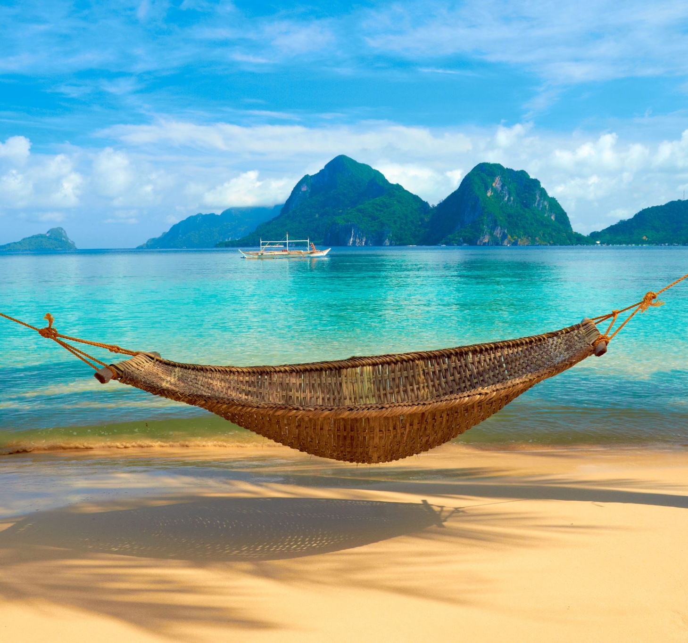
MY DREAM VACATION name – Ananya dey
Bally

Slide 2
travel schedule
DATE | TRANSPORT | HOTEL | ACTIVITES
Feb 14 | KOLKATA TO BALI (FLIGHT) | NIZAM PLACE | SIDE SCENE
Feb 15 | RENT CAR | SUBIR STAY | BEACH TOUR
Feb 16 | BALI TO KOLKATA (FLIGHT) | NIZAM PLACE | SIDE SCENE

Slide 3
Budget Breakdown

Slide 4

Vacation Highlights

Slide 5
Packing List
CLOTHES | GEAR | TRAVEL ESSENTIALS
T SHIRT | DSLR | TOOTHBRUSH
TROUSER | STAND | COMB
 | LAPTOP | HEAD PHONE

Slide 6
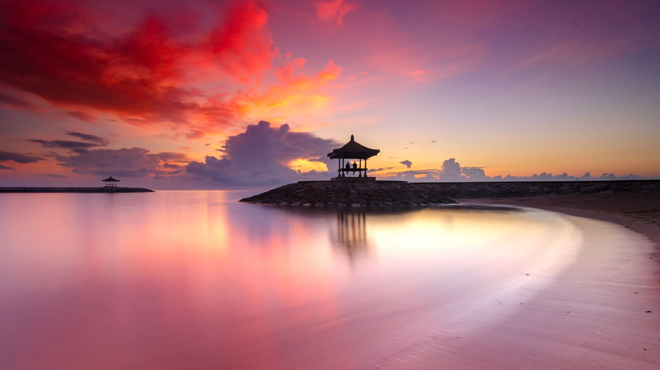

Conclusion “Bali is the perfect mix of relaxation , adventure , and culture . I can’t wait to explore its beauty and unwind on its stynning beaches”

